Slide 1



Corporate Governance “Counter-narratives”:
On Corporate Purpose and Shareholder Value(s)
March 1, 2019
Follow @MillsteinCenter

Slide 2
Session I:
Prosperity and the Future of the Corporation

Slide 3
Stakeholder Income Statement
Line item | Amount | Stakeholder
Sales | XXXXXX | Customers
Wages | XXXXXX | Employees
Cost of goods sold | XXXXXX | Suppliers
Taxes | XXXXXX | Community
Net Income | XXXXXX | Shareholders
Factor
Markets

Slide 4
The broadcast will continue after the break.
Corporate Governance “Counter-narratives”:
On Corporate Purpose and Shareholder Value(s)
March 1, 2019
Follow @MillsteinCenter

Slide 5
Session II:
“Counter Counter-Narratives”: Corporate Governance’s Limited Role in the Current Malaise

Slide 6
Corporate Governance’s Limited Role in the
Current Malaise
Jeffrey N. Gordon
Columbia Law School Millstein Center Conference on
Corporate Governance “Counter-narratives”: On Corporate Purpose and Shareholder Value(s)
March 1, 2019

Slide 7
Based on: Is Corporate Governance a First Order Cause of Economic Malaise?
(2018) Journal of the British Academy, 6(s1), 405–436.

Slide 8
“The Current Malaise”
1. Inequality
2. Economic Insecurity
3. Slow Economic Growth
Throughout the OECD.

Slide 9
“Corporate Governance”
Meaning: allocation of decision-making power and influence within the corporation; in particular (and especially in the US), the extent to which (and the means by which) shareholders exercise power.
“Corporate governance” is not static: difference corporate governance systems could evolve on the top of legal regimes that are relatively stationary (Gilson, 2018).
-- Ownership structure is a key variable
a) diffuse
b) concentrated: (i) single firm blockholder
(ii) collectively through diversified asset managers/institutions

Slide 10
Corporate governance once again in the political news
Sen. Warren: “Accountable Capitalism Act”
Major feature: worker representation on boards
Colin Mayer, Prosperity, offers a distinct corporate governance model that revolves around the “purpose” of the firm and contemplates the possibility that a broad group of those affected by the corporation’s actions, even beyond the customary triad of managers, shareholders, and employees, could play a governance role

Slide 11
Conclusions (in brief): re Inequality
Inequality is a serious problem but corporate governance plays a secondary role in its creation and persistence
  Exec compensation channel (the top 1%)
  Private Equity channel (the top .01%)
  But: More pervasive sources of inequality relate to structural changes in the nature of work and the disparate performance of firms
    EG: Acemoglu & Restrepo (2018), Artificial Intelligence, Automation and Work
    Eduardo Porter, NYT (2019), Tech Is Splitting the US Wok Force in Two
    Autor (2019), Work of the Past, Work of the Future
    Autor et al (2017) The Fall of the Labor Share and the Rise Superstar Firms
Most straightforward way to address inequality is directly before us: the estate tax. To quote Rutger Bregman, the Dutch historian, at Davos: “all the rest is BS in my opinion”

Slide 12
Conclusions (in brief): re Slow Economic Growth
  Corporate governance is not a significant cause of slow economic growth.
  Complaints about under-investment because of stock buybacks and inadequate R&D are empirically weak
  Good analysis of the empirics of R&D, stock buy-backs, and Investment sufficiency:
  Fried, Jesse and Charles Wang. 2018a. “Are Buybacks Really Shortchanging Investment?” Harvard Business Review (March-April): 88-95
  Recent evidence (Steil & Della Rocca 2019) that buybacks are occurring principally in S&P sectors where Return on Capital is below average.

Slide 13
Conclusions (in brief): re Slow Economic Growth, 2
*Alternative hypothesis: Slowing pace of real innovation (R. Gordon 2016)
*Alternative hypothesis: Government short-termism. Impact on corporate planning of potential currency breakdown (the Euro); trade-disruptions and sudden stops in talent flow (Brexit); potential supply-chain disruptions (US turn to economic nationalism, neo-mercantilism)
Alternative hypothesis: Governments’ post-crisis policy failure in pursuing austerity.
Thus: Looking to firms’ cash reserves as source of privately-supplied Keynesian stimulus

Slide 14
Conclusions (in brief): Economic Insecurity
Herein is the deep, genuine problem: disruption from job loss, not just steady income stream but loss deriving cut-off from Employer-provided social welfare system: health insurance and retirement planning
The consequence of capital markets development and product market pressure (global factors; disruptive domestic competition) has produced the Great Risk Shift: away from shareholders, who can diversify firm-specific risk, towards employees, who cannot
“Corporate governance” is principally the mechanism by which these external factors are registered by the specific firm but trying to “fix” corporate governance is to aim at the wrong problem

Slide 15
Conclusions (in brief): Economic Insecurity, 3
Economic insecurity: Risk shift to employees is principally an insurance problem, which no single firm is equipped to address.
Needed: a new “match” between government and private enterprise that will recognize the need to subsidize human capital renewal throughout an employee’s career, not just one-time, K-12 or 16.
  Can be defended on distributional grounds but stronger defense is that such investments have high payoffs.
  Neo-classic defense of layoffs is that firms should not waste resources that can be put to higher, better use. Various frictions impair value-creating redeployment; self-insurance against skills obsolescence is not feasible
  Think demography: Higher fraction in employment adds to growth potential

Slide 16
Conclusions (in brief): Interesting position of asset managers
1. Core product is low-cost diversified portfolio, so only way to improve outcomes for purchasers is by increasing returns/lowering systematic risk across the portfolio as a whole (ie, the whole economy)
2. Concern about disruptions associated with high-powered corporate governance: adds a certain kind of systematic risk of a populist rejection of corporate governance that maximize expected return.
Thus: stability-seeking. Is that what stewardship is really about?
What about more assertive engagement with social insurance schemes that complement high-powered corporate governance?
-- Would this require entry into “politics” that would bring unwelcome attention and thus threaten the business model?

Slide 17
Capital market background
Rise of diversification:
  1. As a theory: Investors should/do pursue “utility maximization,” meaning, highest risk-adjusted expected returns
  2. Which can be obtained through portfolio diversification
  3 Which minimizes firm-specific (“idiosyncratic”) risk
  **Thus Investors want firms to pursue highest net present value projects, irrespective of greater risk of financial distress/bankruptcy
  ** Thus investors disfavor diversification at the firm level (“conglomerates”) because they can obtain diversification at the portfolio level; thus greater risk at focused firm level

Slide 18
Capital market background, 2
Creditors of such riskier firms can “adjust” through compensatory interest rate hikes
Managers of such risker firms can adjust through stock-based pay and severance arrangements (“golden parachutes”)
Employees: are likely to bear the extra risk without compensation

Slide 19
Enhanced competitive pressures
Trade expands the set of competitors
Domestic disrupters (eg, Walmart, Amazon, Netflix – all dramatically changing prior systems of retail distribution)

Slide 20
“High-Powered Corporate Governance”, 1
Channel: the Rise of “High-Powered Corporate Governance”: the strategies/mechanisms by which shareholders (increasingly, institutional owners) have insisted on “efficiency” (from shareholder point of view)
1. Hostile Tender Offers, 1970s, 1980s (overcome “rational apathy”/free-riding that impeded shareholder “voice” as a disciplinary mechanism)
-- Produced “governance externalities”: the main reason for the virtual disappearance of hostile bids (not “Just Say No”)
-- Prior to hostile bids, firms could run with considerable “slack” from shareholder point of view, at a level that could make a hostile bid profitable even with a 40% premium

Slide 21
High-Powered Corporate Governance”, 2
--To avoid being targeted, managements (and boards) followed slack-reducing strategies
--Biggest impact of hostile bid movement was though such the “external effects,” changing the way public firms were run
Important channel for reducing slack: down-sizing the labor force, closing marginal plants and facilities

Slide 22
High-Powered Corporate Governance”, 3
2. Shareholder activism, 2000s-present
  Reconcentration of ownership in institutional investors opens the way for exercise of shareholder voice, potentiated by activist investors
  -- Change in ownership concentration means activists can develop a “reputation” and shareholders can be mobilized
  -- Consequence: firms operating with lower level of “slack” can be targeted
Once again: -- To avoid being targeted, managements (and boards) followed slack-reducing strategies
--Biggest impact of hostile bid movement was though such the “external effects,” changing the way public firms were run
Important channel for reducing slack: down-sizing the labor force, closing marginal plants and facilities

Slide 23
High-Powered Corporate Governance”, 4
Consequence: Economic instability from “Displacement”
  Classic theory about “job loss”: frees up human resources that can be put to higher and better use
  Empirical effects: “Displacement” on average leads to permanent decline in wage levels (firm specific investments are lost; exacerbation if dominant employer in the region; mobility frictions; diminishing regional convergence)
  Economic insecurity may have significant effects on wages: competitive environment and rapidity of translation into down-sizing constrains concerted activity (declining unionization) and even local “asks”

Slide 24
Reframing the Great Risk Shift/Economic Insecurity as an Insurance Problem: Insurance demand/market failure
Problem of economic insecurity (as exacerbated by High Powered Corporate Governance) is an insurance failure
Firms are unable to provide the insurance employees would desire, either directly or through third parties
Directly: deferred compensation as the premium?
  How to set premium given (i) changing business risks;
  (ii) cross-sectional variation within employee groups and over time on relative risk exposure/risk-bearing capacity?
  (iii) variation in optimum payouts: salary replacement (subject to co-insurance) vs. retraining/human capital renewal, other adjustment assistance
  --Subject to shareholder opportunism? Transactions that reduce capacity of firm to make insurance payouts.
  --Subject to Business reversals that undermine the firm’s capacity to make payouts

Slide 25
Firm-level displacement insurance?
    Protecting the Firm-level Insurance Promise
    -- Separate Funds, like Defined Benefit Pension Plans (reinvestment risk? Assumed rates of return?)
    -- Third Party Insurers (Moral Hazard risks)
    BIG Problem: If left to single firm choice, consequence could be adverse selection effect in employee recruitment

Slide 26
Market failure: government role
Government can provide insurance that no single firm can provide
Insurance solutions: not just better risk-sharing or redistributive (“fairness”), but facilitates conservation/higher valued use of scare human resources
Helps address Slow Economic Growth

Slide 27
Reframe: Government “match”
Alternatives way to conceive of government role is new form of government/private sector match
No one would think for firms to provide basic education to employees: core training is socially provided. Government facilitates “start up” acquisition of human capital
In an economy where competitive factors will likely impose continual adjustment costs, Government match may now include support for on-going acquisition of human capital
Facilitates growth and productivity; augments employee bargaining power by strengthening outside options

Slide 28
Asset managers redux
If welfare of customers of systemic-risk bearing clients can be improved by only by improved economy-wide performance or by systemic risk reduction, what are the demands of “stewardship”?
If genuinely active, not “passive,” what are the boundaries of activism where welfare enhancement requires collective action?

Slide 29
The broadcast will continue after the break.
Corporate Governance “Counter-narratives”:
On Corporate Purpose and Shareholder Value(s)
March 1, 2019
Follow @MillsteinCenter

Slide 30
Session IV:
Power Within the Corporation and Corporate Purpose: The Inescapable Link

Slide 31

Leo Strine and the Big Picture
Mark J. Roe
Columbia Law School
Corporate Counter-Narratives
March 1, 2019

Slide 32
Two Big Picture Ideas in the Academic Work of Leo Strine
One: The public corporation has to work, and be seen as working, for the average person.
Two: Stock-market short-termism, relentless trading, deeply damages the American corporation.
  Implicitly, short-termism causes the first problem. (Not the only cause.)

Slide 33
On the two
On the first, I’m in complete agreement.
  1. For the corporation to be shielded from populist attacks, it has to work for enough people.
  2. The base purpose of our work is utilitarian, the greatest-good for the greatest number.
On the second core issue in Leo Strine’s work, corrosive short-termism: what is the evidence that the economy suffers from short-termism?
Which should we talk about, one or two?

Slide 34
Aside: which is the counter-narrative?
Stock-market short-termism is WIDELY seen as a core part of the modern public corporation.
Examples follow.
Here: the counter-narrative is that stock-market short-termism is NOT a deep, serious economy-wide problem.
FIRST: the generally accepted principle:

Slide 35
Martin Lipton’s well-known, classic justification to further empower managers to defeat hostile takeovers:
“It would not be unfair,” he wrote, “to pose the policy issue as: Whether the long-term interests of the nation’s corporate system and economy should be jeopardized in order to benefit speculators interested . . . only in a quick profit . . . ?”
  Martin Lipton, Takeover Bids in the Target’s Boardroom, 35 Bus. Law. 101, 104 (1979).

Slide 36
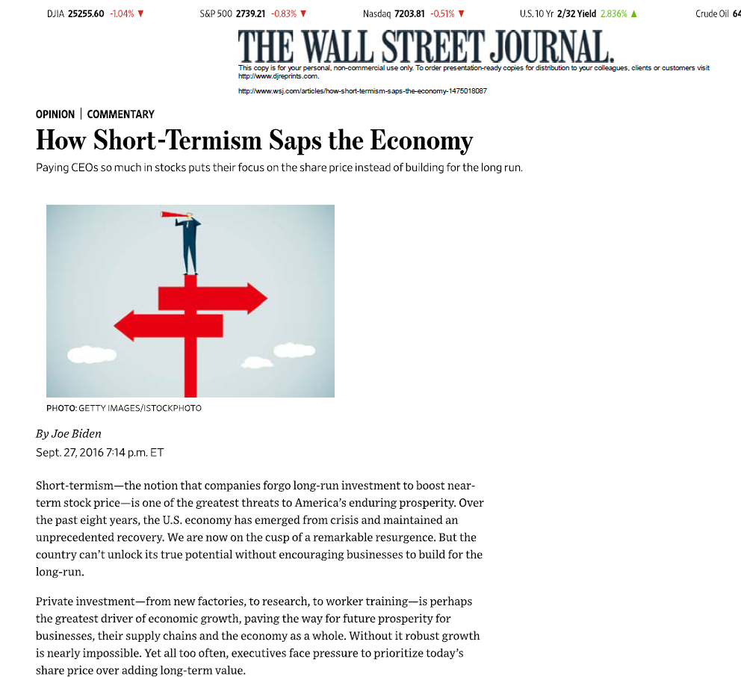

Slide 37
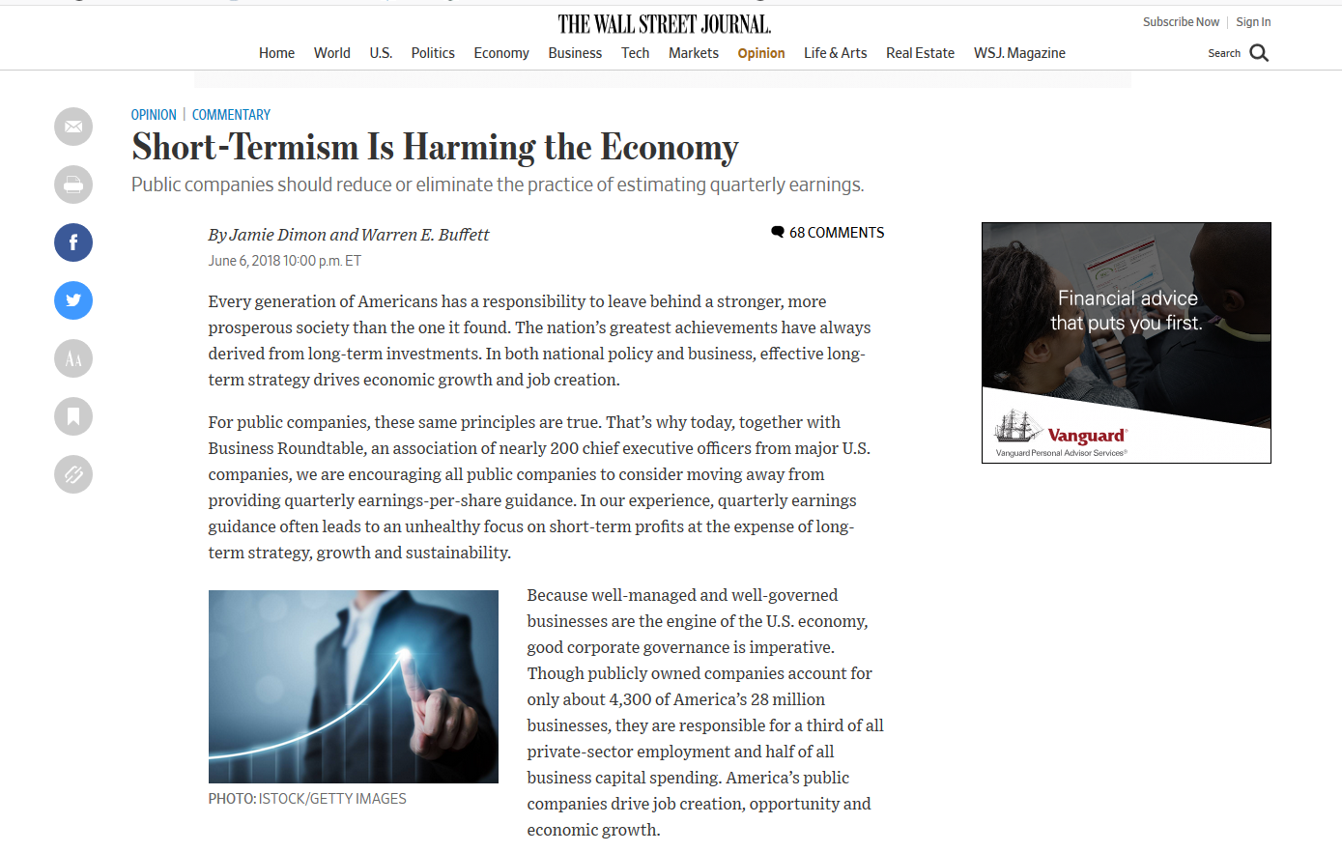

Slide 38
Leo Strine on Short-Termism
The title says the thesis: Leo E. Strine, Jr., One Fundamental Corporate Governance Question We Face: Can Corporations Be Managed for the Long-Term Unless Their Powerful Electorates Also Act and Think Long Term?, 66 Bus. Law. 1, 8, 11, 26 (2010).
“[D]irectors are increasingly vulnerable to pressure from activist investors . . . with short-term objectives,” he says, “lead[ing them] to . . . sacrifice long-term performance for short-term shareholder wealth.”
  Leo E. Strine, Jr., The Dangers of Denial: The Need for a Clear-Eyed Understanding of the Power and Accountability Structure Established by the Delaware General Corporation Law, 50 Wake Forest L. Rev. 761, 790-91 (2015).
Strine as corporate thinker not as corporate judge.

Slide 39
Bad economy-wide impact of stock-market short-termism
One: Cutbacks in capital expenditures.
Two: Stock buybacks starve firms of cash, necessitating
Three: Hit to R&D (and capex and employee welfare)
Four: Stock market does not support longer-term innovation
Making the economy much weaker than it should be

Slide 40
Evidence
For stock-market-driven short-termism
Primarily firm-level
  Divided
  Do firms with more stable shareholder base do more R&D? Do they invest more?
  Do hedge fund interventions degrade long-term shareholder returns or not?
Hard to extrapolate economy-wide impact from firm-level evidence
  Even if there’s a loss, is any loss made up for elsewhere---private ownership, other public firms

Slide 41
Bullet Points: II
Results (and then graphics)
  Capital spending is declining, (1) since 2009 (2) everywhere in the developed world, even in nations lacking strong stock markets and shareholder activism
  Buybacks’ net cash impact approaches zero. Borrow to buy back.
  Cash isn’t being stripped. Cash position is rising overall.
  And moving from larger, older firms to smaller, younger ones.
  R&D not declining.
    Structural reasons to be skeptical that the stock market kills R&D
    Direction doesn’t say whether stock-market is holding back more R&D
  Strong stock market support for longer-term firms.
No major consequence of short-term narrative can be found in the economy-wide data or is hard to trace to the stock market
  Pause: doesn’t mean that can’t possibly find. Does mean that not brought forward and maybe can’t find.

Slide 42
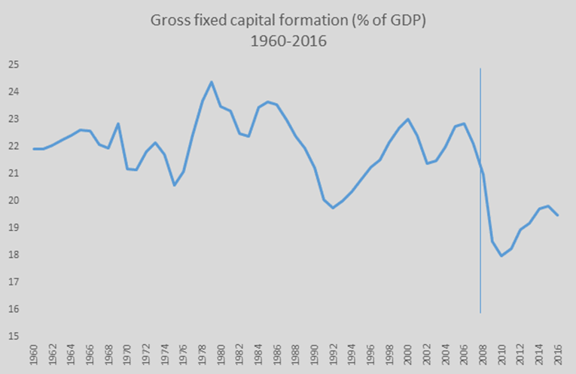
Prominent complaint #1:
Capital spending is declining
Capital Expenditure/GDP, 1960-2016
Source: The World Bank. Gross fixed capital formation (% of GDP). World Bank national accounts data, https://data.worldbank.org/indicator/NE.GDI.FTOT.ZS?end=2016&start=1960&view=char (accessed Jan. 8, 2018).

Slide 43
Why is it declining?
Hypothesis 1: stock-market trading and activist interventions
Hypothesis 2: weak economy
Hypothesis 3: economic change. Is Capex also declining where stock markets are less important than in the U.S.?
  Post-industrial economies
  Secular stagnation
  China, India

Slide 44
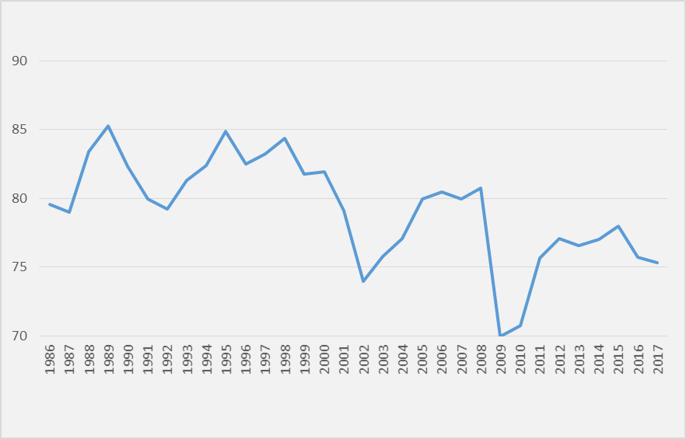
Weak Economy: Capacity Utilization Over Time
Still hasn’t recovered from financial crisis
Source: Federal Reserve Bank of St. Louis.

Slide 45
Economic change: Is capex down elsewhere?
Where stock markets are unimportant and activist interventions are rare?
The Similar Capital Expenditure Trends throughout the OECD
Source: the World Bank National Accounts, Gross fixed capital formation (% of GDP), https://data.worldbank.org/indicator/NE.GDI.FTOT.ZS?end=2016&start=1960&view=char (accessed Jan. 2, 2018). Standard and Poor’s did a similar comparison, reproduced in Appendix Figure 7, showing North American capital expenditures moving in tandem with the rest of the world’s.
See Roe, Stock-Market Short-Termism’s Impact, 167 U. Pa. L. Rev. 71 (2018).

Slide 46
Explanations
Is the stock market the likely culprit?
  Movement of basic manufacturing to China
  Post-industrial economy uses less capital equipment
  More efficient use of existing capital equipment
  Mismeasurement
    Hard assets are well-measured. A long history of accounting science in measuring.
    Intangibles are not as well-measured. The 21st century advanced economies are more about intangibles than 20th century economies.

Slide 47
Is cash disappearing?
Net buybacks, net long-term borrowings
Rise in Both Net Stock Buybacks and in Net Borrowing in the S&P 500, 1985-2016
Source: The compustat database was the source for the buyback data. Compustat Industrial [Annual Data], Standard & Poor’s [accessed various dates in Jan. 2018]. Retrieved from Wharton Research Data Service.
See Roe, Stock-Market Short-Termism’s Impact, 167 U. Pa. L. Rev. 71 (2018).

Slide 48
Cash, bottom-line
Response: we know that hedge fund activists target firms with cash (the activists say “excess cash”) and force payouts, buybacks, and applications of cash.
So what’s happening to cash overall?

Slide 49
S&P 500 Cash-on-hand as Portion of GDP, 1971-2016

Slide 50
Prominent Complaint #3, R&D
R&D Spending in U.S. as a Proportion of GDP, 1977-2016
R&D Expenditures in the Non-Financial S&P 500, 1975-2016
R&D in the Non-Financial S&P 500, Scaled by GDP, 1975-2016

Slide 51
R&D
It could be more.
I.e., perhaps the stock market is holding the economy back from even more (good) R&D
  Hard to measure.
  Burden of proof: critics have not shown an economy-wide hit to R&D
But we could judge whether the stock market can and does support future-oriented companies

Slide 52
The Stock Market Doesn’t Support the Long-Term and Innovation
Rank | Company Name | Market Cap ($Billions)
1 | Apple | 1054
2 | Amazon | 947
3 | Microsoft | 868
4 | Alphabet (Google) | 812
5 | Facebook | 463
6 | Johnson & Johnson | 375
7 | Exxon Mobil | 354
8 | Walmart | 279
9 | AT&T | 245
10 | Home Depot | 241
Ten Largest U.S. Nonfinancial Public Firms, by Stock Market

Slide 53
Summary of the (Counter?-)Narrative
The evidence is not there that stock-market-driven short-termism is killing the economy.
Why the gap between rhetoric and data?
Probably the first issue: the corporation is seen as not delivering. Policymakers, media who don’t want to attack capitalism and shareholders, latch onto shareholding gone awry---short-termism.
  But they’re really complaining about fairness, with short-termism spurious.
Risks: misdirected remedies
  E.g., can’t reduce inequality meaningfully through short-termism.
  If reduced competition is the problem….

Slide 54
END

Slide 55
Power within the Corporation and Corporate Purpose: The Inescapable Link
Jill E. Fisch

Slide 56
The Starting Premise – Is there an Urgent Need to Change?
What is our data set?
Which corporate issues do we see?
What are the factors that drive the average person’s level of trust?

Slide 57
Expectations for Business
Businesses today are bigger
They are global
They are political actors
They are subject to the demands of an increasing number of stakeholders
They are interconnected
They are viewed as having access to more information and required to respond to that information

Slide 58
Corporations and Social Purpose
The myth of common purpose
Who decides a corporation’s social purpose?
  Executives, directors, stockholders, other stakeholders, lawmakers, the average person?
  How do we reconcile differences and set priorities?
  Issues of competence and expertise
  What about agency costs?
Changing corporate purpose is not a response to wealth and income inequality

Slide 59
Corporations and Shareholder Value
What do we mean by stewardship?
Does it mean compelling corporations to consider non-shareholder value?
Which non-shareholder values count?
Is shareholder value limited to economic value (cabining the short/long term debate)?
If shareholder value includes non-economic considerations, who decides what those considerations are?

Slide 60
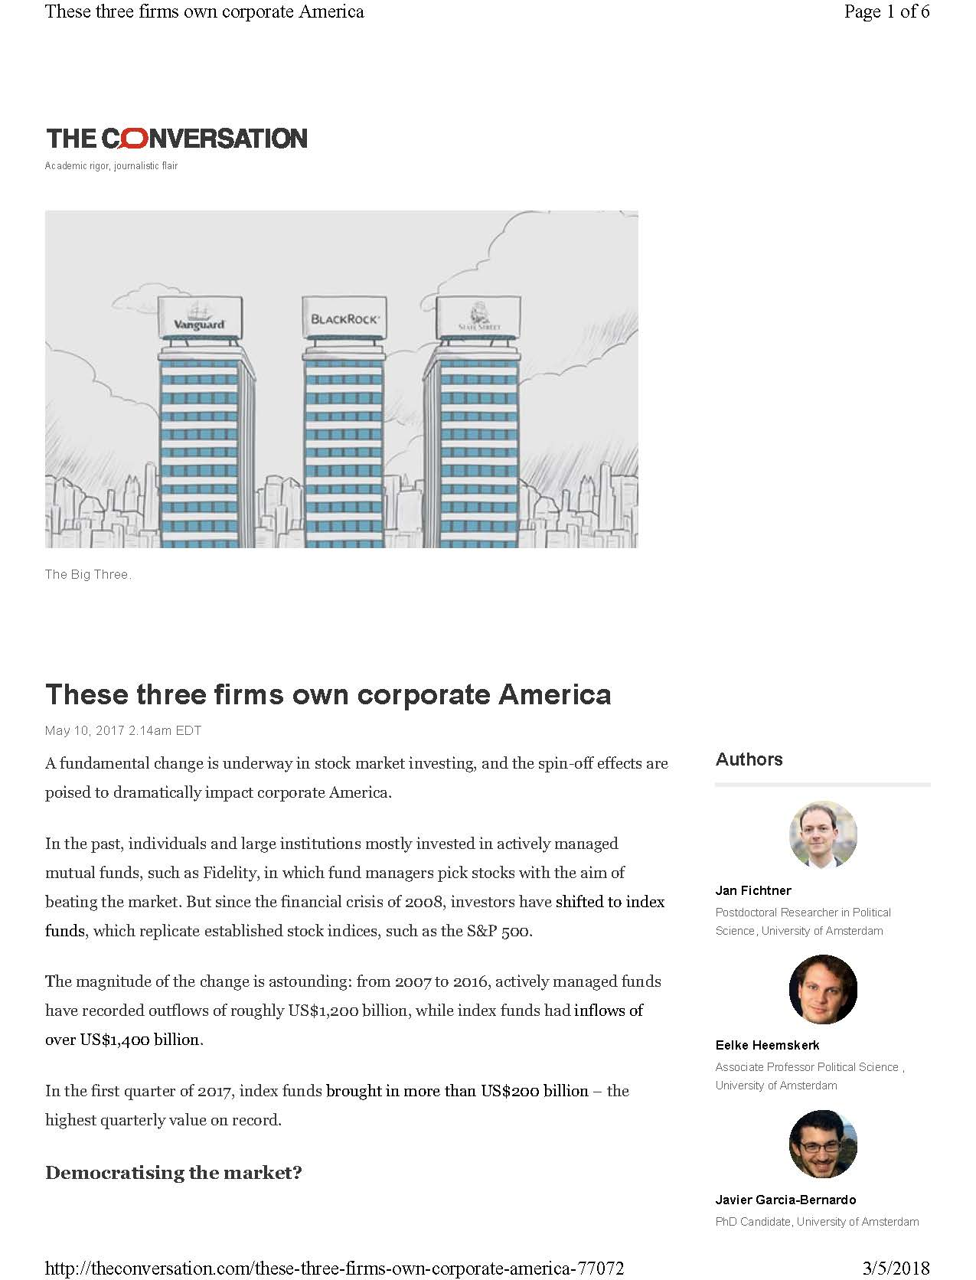
Corporate Social Purpose and Agency problems
I’ve written a fair amount on the increasing power and engagement of institutional investors
Typically, we mean asset managers

Slide 61
Corporate Social Purpose and Agency problems
Asset managers are not shareholders – they are intermediaries
As such, they have their own incentives and objectives
Are we talking about their objectives or those of their beneficiaries?

Slide 62
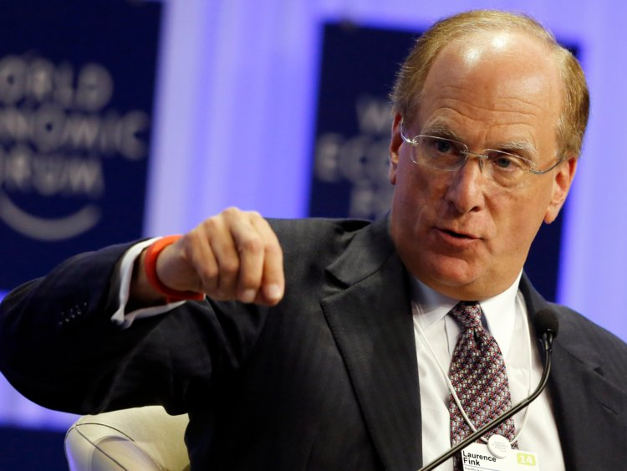
For whom does Larry Fink speak?
Himself?
BlackRock?
The shareholders in BlackRock’s mutual funds?
How do we decide what they value?

Slide 63
Leo Strine and the Revolution to Come
Bruce Kogut
Graduate School of Business and Department of Sociology
Columbia University

Slide 64
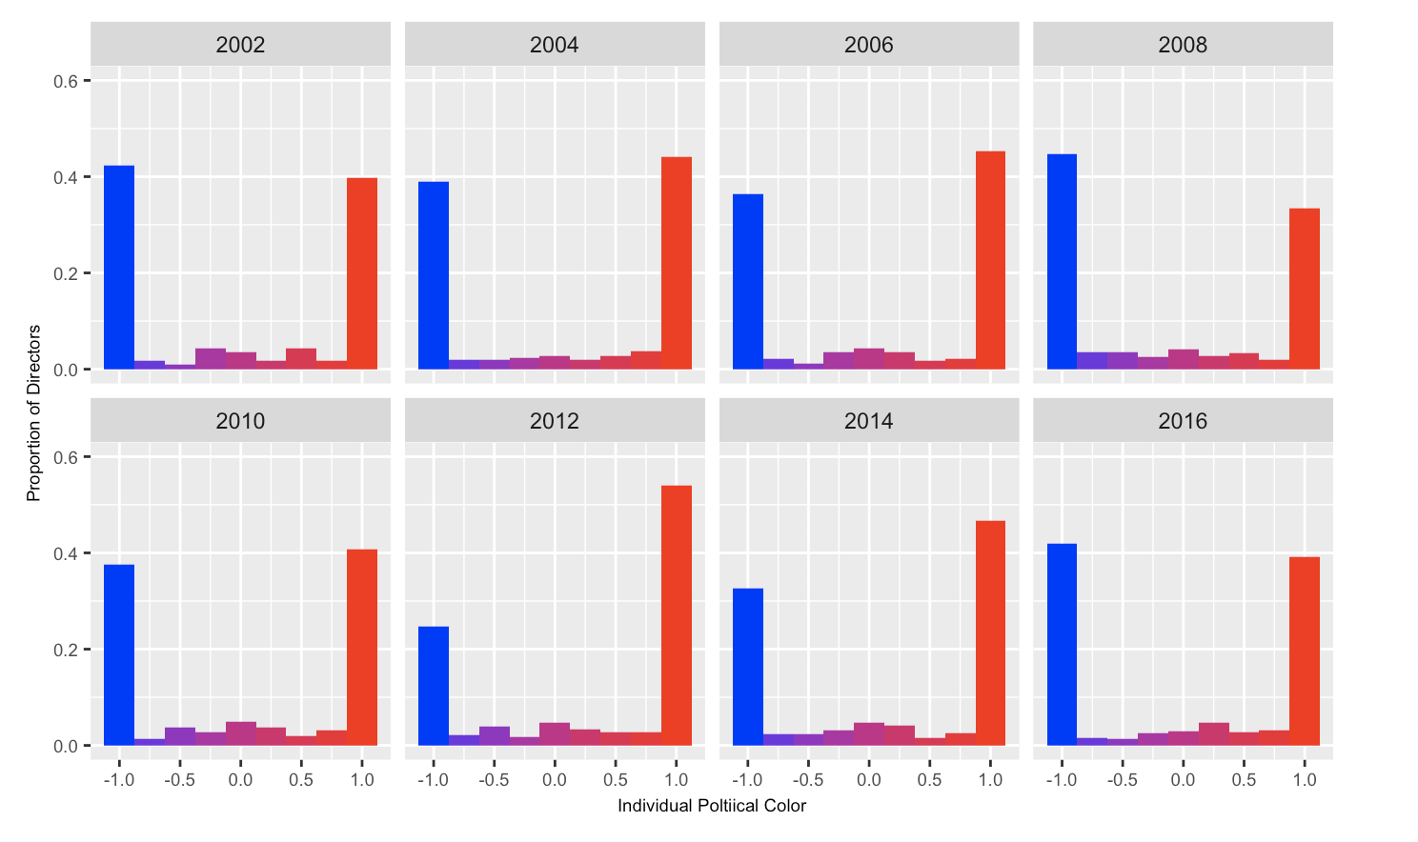
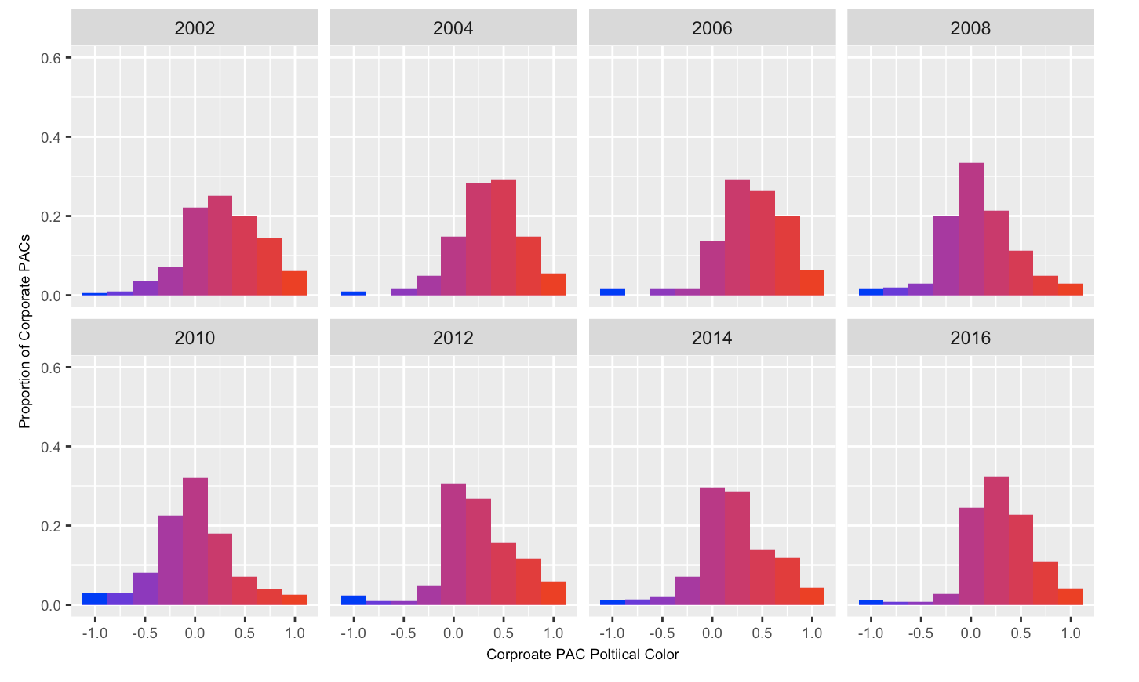


Ideological Individuals, Bipartisan Firms
- Ideologically extreme directors increasing in proportion after 2008 Election Cycle
Histogram of % Proportions of Elites and Firms by Political Color
a. Individual S&P Directors’ Donation and CEOs by Political Color
b. S&P 500 Corporate PAC Political Color
Ideological Individuals
Bipartisan Firms
Individual Political Color (S&P 500 Directors and CEOs)
Individual Political Color (S&P 500 Directors and CEOs)
S&P 500 Corporate PAC Political Color (based on expenditures to Candidates)
S&P 500 Corporate PAC Political Color (based on expenditures to Candidates)
Note: Width of each bin is 0.25. Contribution amount deflated, with base year as 2016 election cycle
Source: OpenSecrets.org (https://www.opensecrets.org/bulk-data/downloads#campaign-finance)
Note: Width of each bin is 0.25. Contribution amount deflated, with base year as 2016 election cycle
Notes:
Proportion = percentage. We normalize the # of directors by dividing it by total # of directors with contribution record in the given election cycle
Binning by the % of directors – how many directors are in each bin?

Slide 65
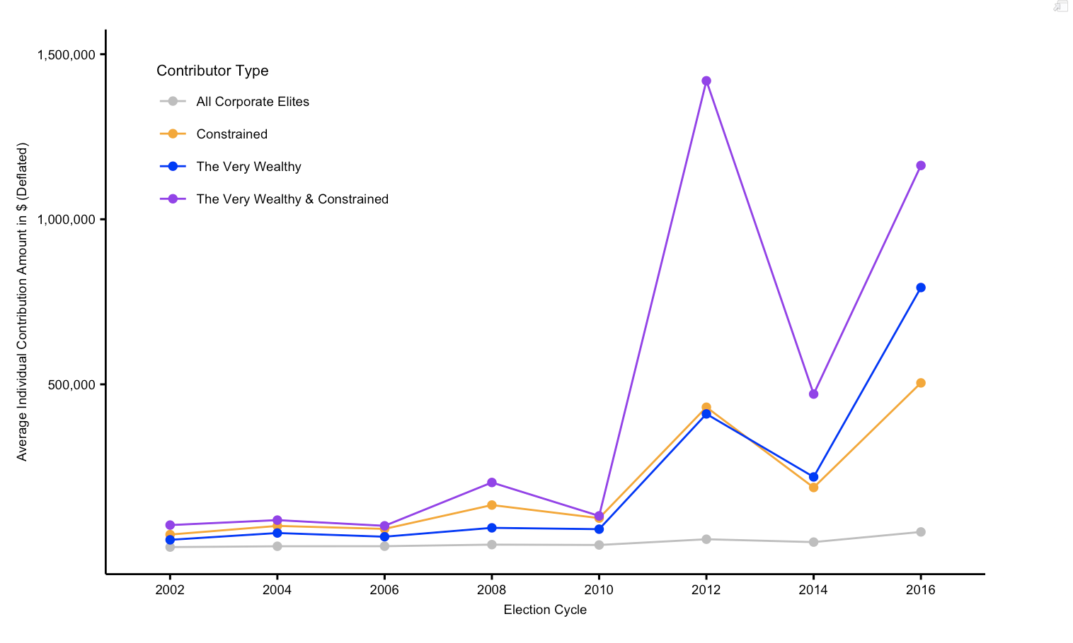
Most Drastic Increase in Average Individual Contribution for The Very Wealthy in 2012
Note: Contribution amount deflated, with base year as 2016 election cycle.
Notes:
Note for Angela: original file name =“Average_indiv_contributor_type_allcomm.eps”
What does ALL mean: all business elite? Or everyone who donates?

Slide 66
Stakeholder Governance, Complexity and Cognition
Commentary by Eric Talley (Columbia)

Slide 67
Reservations about Stakeholder Primacy approach
Relies on a hard-to-test enabling assertion:
  Limiting Accountability to SHs => Greater Accountability to Overall Stakeholder Value
Pretext and Accountability
  Will managers invoke stakeholder governance as a cover for agency costs / self-interest?
Cognition and complexity:
  Even absent agency cost / monitoring issues “narrow constituency” primacy may be second best proxy for stakeholder governance, even assuming that the appropriate goal is to maximize enterprise value…

Slide 68
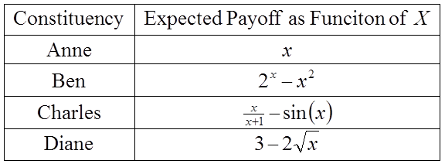
Pilot Experiment Hypothetical (Preliminary):
You are the manager of a public corporation
Task: Decide the firm’s “production” for current period:
  Production could be any number between 0 and 5 (continuous scale)
  Denote your choice with variable “X”
Four Corporate Constituencies, each receiving a distinct individual payoff as a function of X:
What would you choose if told to maximize the expected welfare of….
  Anne? Ben? Charles? Diane? Total Enterprise Value (i.e., sum of all 4 payoffs)?

Slide 69
Constituents’ Respective Payoffs,
Depicted Graphically
$12.32 = 1st Best
@ x=5
Enterprise
Ben
Anne
Charles
Diane

Slide 70
Mean Total Enterprise Value Obtained, by Assignment Pool
Total Enterprise Value Obtained
N=53

Slide 71
Why Might “Total Enterprise Value” Subjects Underperform the “Anne” and “Ben” Subjects?
Conjecture: Sound fiduciary principles in complex environments must articulate aspirations combining 2 factors: Simplicity and Proximity
Simplicity:
  Both Anne’s and Ben’s payoffs were far easier for subjects to comprehend than were the total enterprise payoffs (Anne’s in particular)
Proximity:
  Both Anne’s and Ben’s payoffs served as reasonably accurate (albeit imperfect) proxies for Total Enterprise Value (Ben’s in particular)

Slide 72
The broadcast will continue after the break.
Corporate Governance “Counter-narratives”:
On Corporate Purpose and Shareholder Value(s)
March 1, 2019
Follow @MillsteinCenter

Slide 73
Session V:
Corporate Governance in the Context of Global Economic Circumstances

Slide 74
Basic Issues
Unhappiness with economic performance
  Global in nature
  Japan
  Europe
  U.S.
  China
Structural change (global) or corporate behavior (local)
Corporate governance not the problem
Problem is global economic transition
Corporate governance change will not help and is likely to hurt

Slide 75
Macroeconomic Dislocations
Ordinary Cycles | Self correcting Short down cycle/recovery Narrow consequences
Structural Cycles | Non-self correcting Extended down cycle Broad consequences

Slide 76
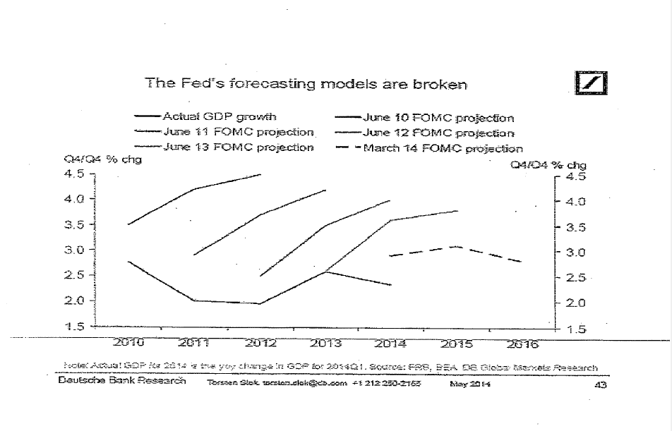

Slide 77
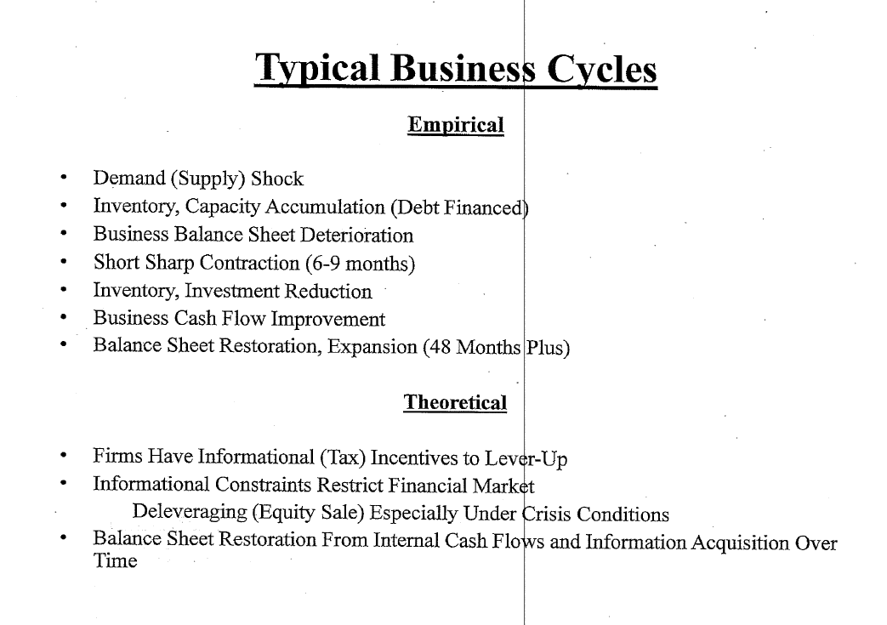

Slide 78
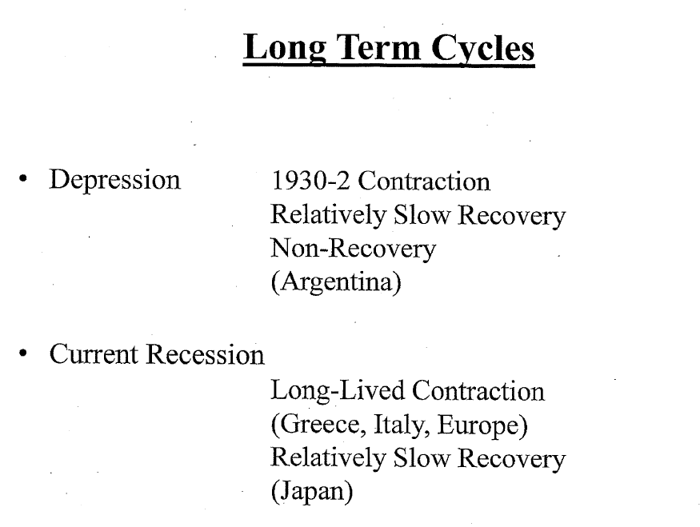

Slide 79
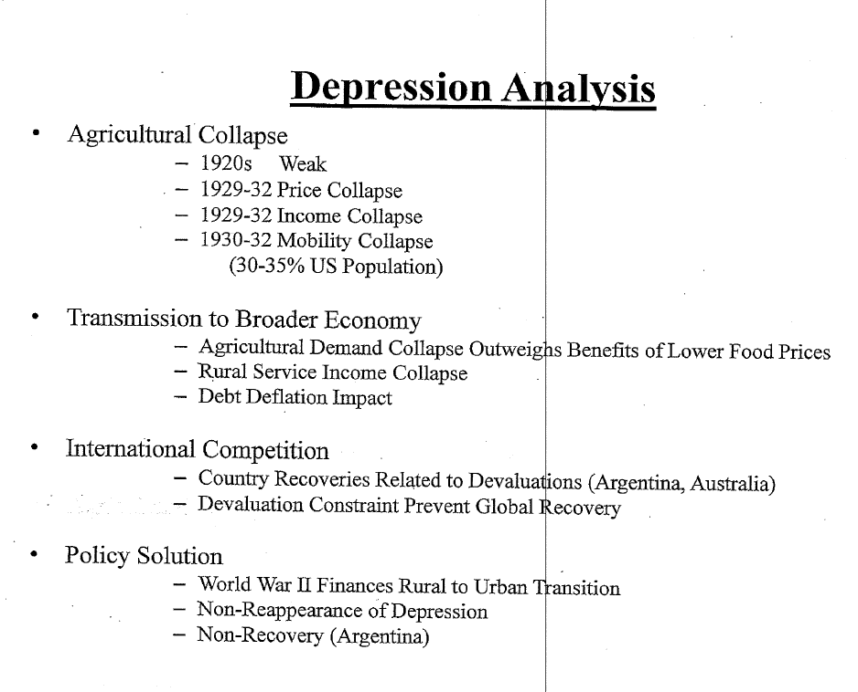

Slide 80
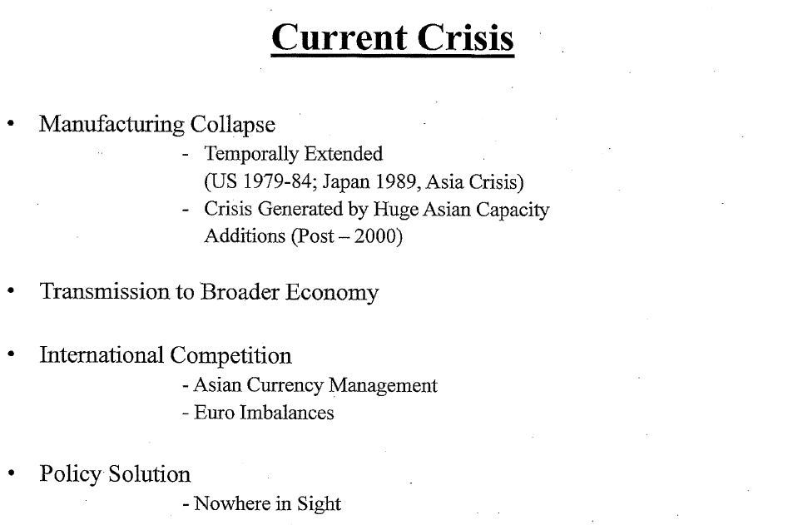

Slide 81
Common Symptomology
(Depression / Current Crisis)
Extended Downturn (10 Years)
International Imbalances/Deflation
Financial Market Dislocations

Slide 82
Global Financial Markets
(Payment Imbalances, Chronic Surplus)
Japan – Self-Protection
Germany – Industrial Policy
China – Macro Stimulation
Korea – Never Again
Saudi Arabia – Oil Prices

Slide 83
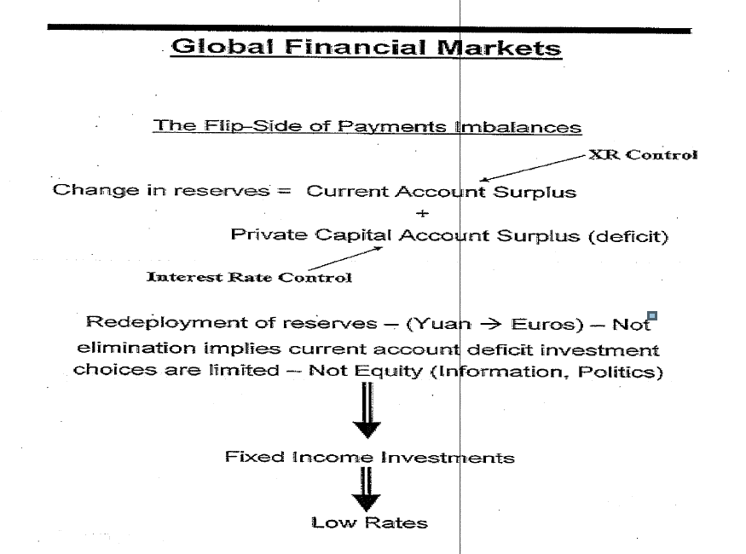

Slide 84
Global Financial Markets
(Stability)
No non-US Countries Have Good Choices
  Either A Current Account Deficits
  or B Dollar Asset Accumulation
US is Walking Tightrope
  Continued Dollar-Goods Exchange
  PLUS
  Continued Macro Deflationary Pressure

Slide 85
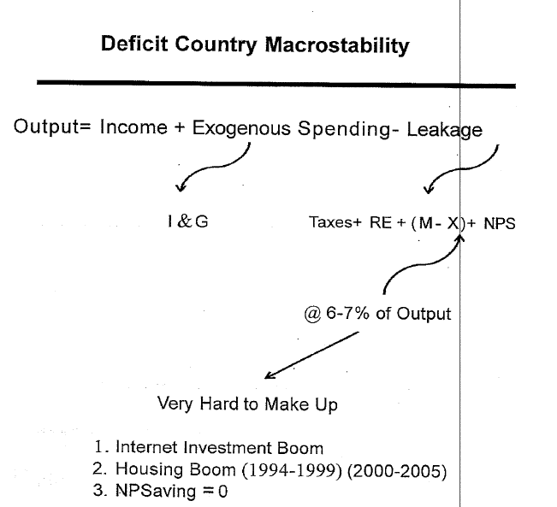

Slide 86
Differences
 | Depression | Crisis
 | Centralized (AGR → Manufacturing) | Decentralized (Manufacturing → Services)
Economic Activity | Local Production Global Distribution (Consumption) | Local Production Local Distribution
 | Geographic Dislocation | Skill Dislocation
Productivity | Positive | Negative
Labor Income | Joint Product | Individual Product
Skill Requirements | Individual (Controlled) | Social (Uncontrolled)

Slide 87
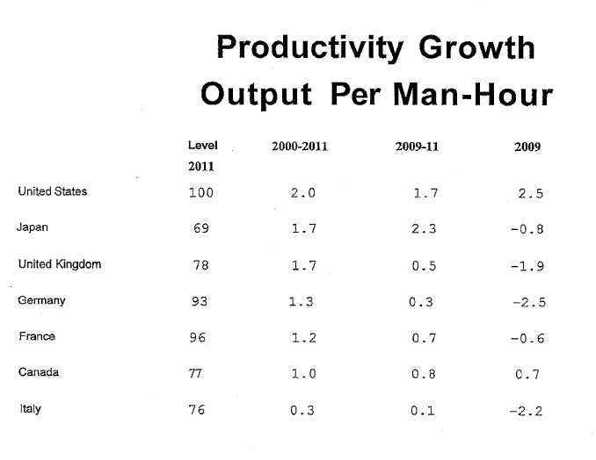

Slide 88
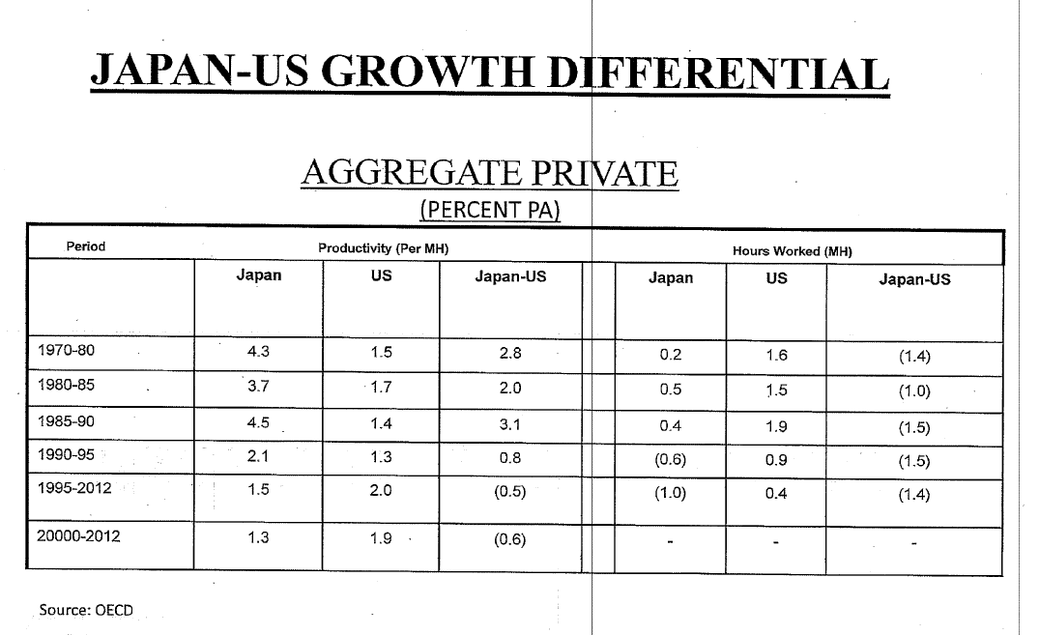

Slide 89
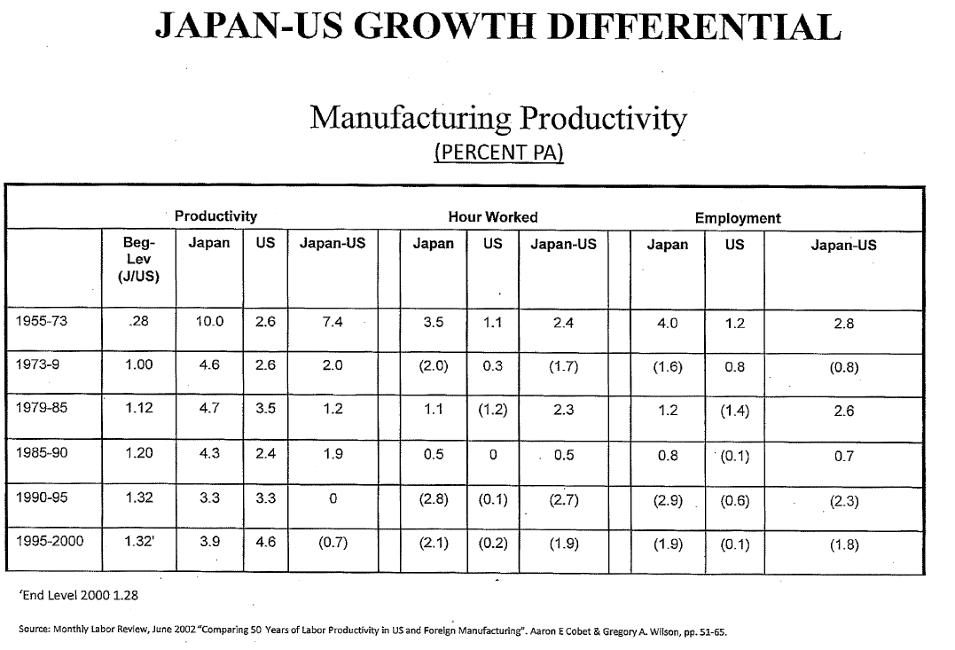

Slide 90
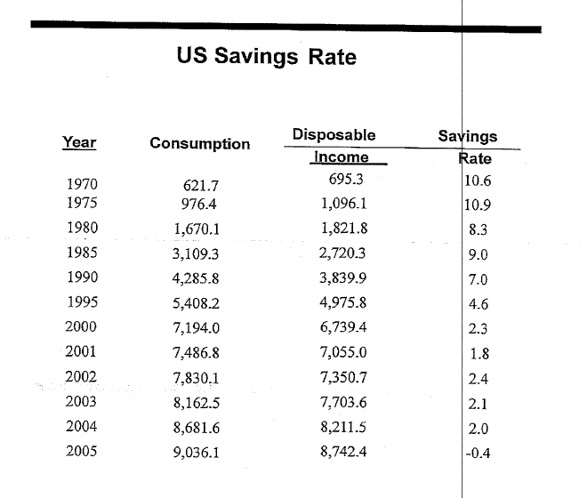

Slide 91
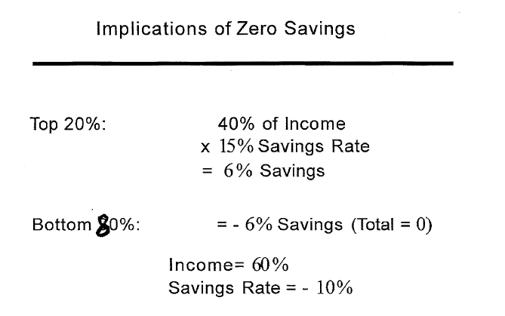

Slide 92
Differences
 | Global Distribution | Local Distribution
Profit Share | Low | High
Investment | High | Low
Price Sensitivity | Low | High

Slide 93
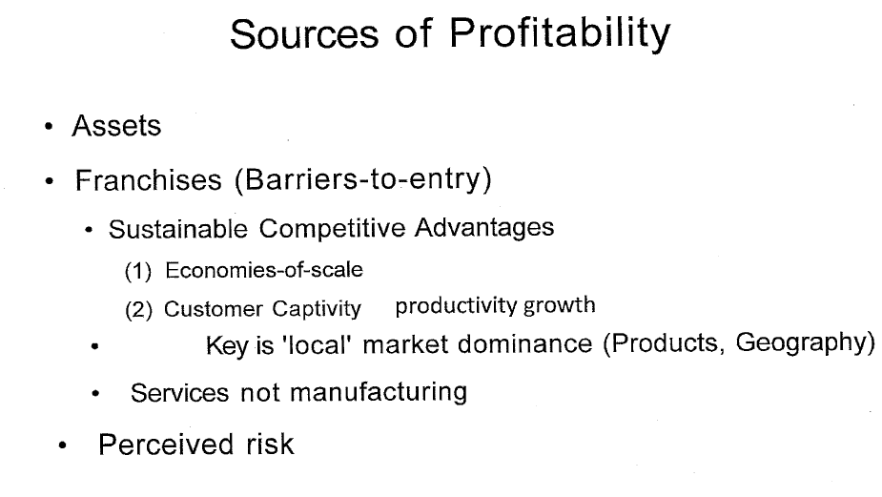

Slide 94
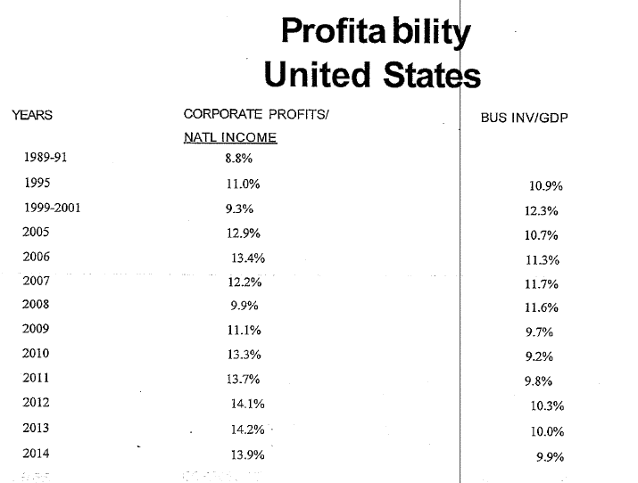

Slide 95
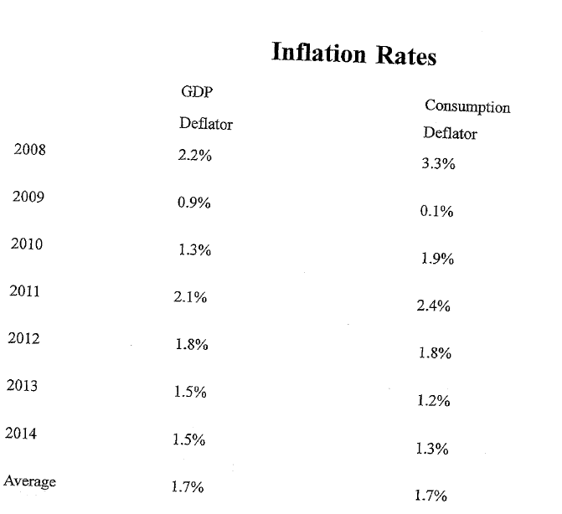

Slide 96
Differences
 | Geographic Dislocation | Skill Dislocation
Relocation | Physical | Psychology
Job Quality | Improvement | Deterioration
Re-Education | Limited | Extensive
WWII Finance?

Slide 97
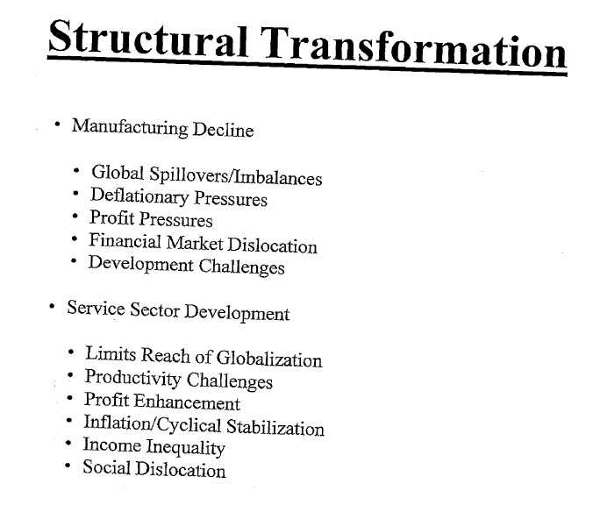

Slide 101
Find more information on our website, millsteincenter@law.columbia.edu
Follow us @MillsteinCenter

